Slide 1
Migration-as-a-Service POC Demo
OCC Engineering team
Srichand Jakka

Slide 2
Agenda
1
Overview
2
Zerto Capabilities
3
Rehost Migration Process
4
Refactoring
5
Q&A

Slide 3
Migration-as-a Service Overview
Optum Connect provides the Cloud Implementation strategy as a service to the customers which includes application assessment and migration-as-a-service to the cloud
Provide seamless migration to the Cloud with end-to-end automation
Optum Connect Cloud(OCC) team recommends Zerto as a preferred Migration tool for Lift & Shift (Rehost) migrations
Refactor application / Database with minimal code change to use Cloud native benefits
Refactoring helps the customers to reduce the infra cost and increase scalability/agility

Slide 4



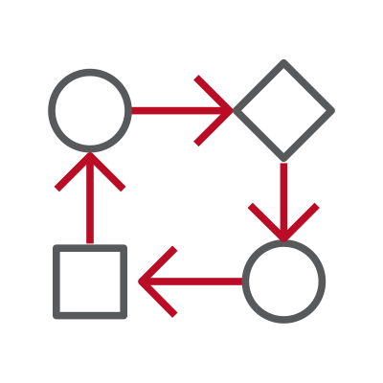
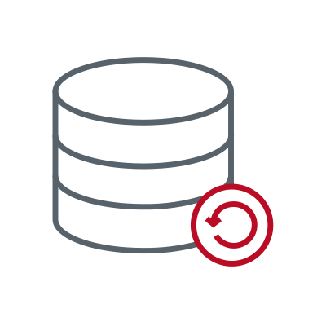



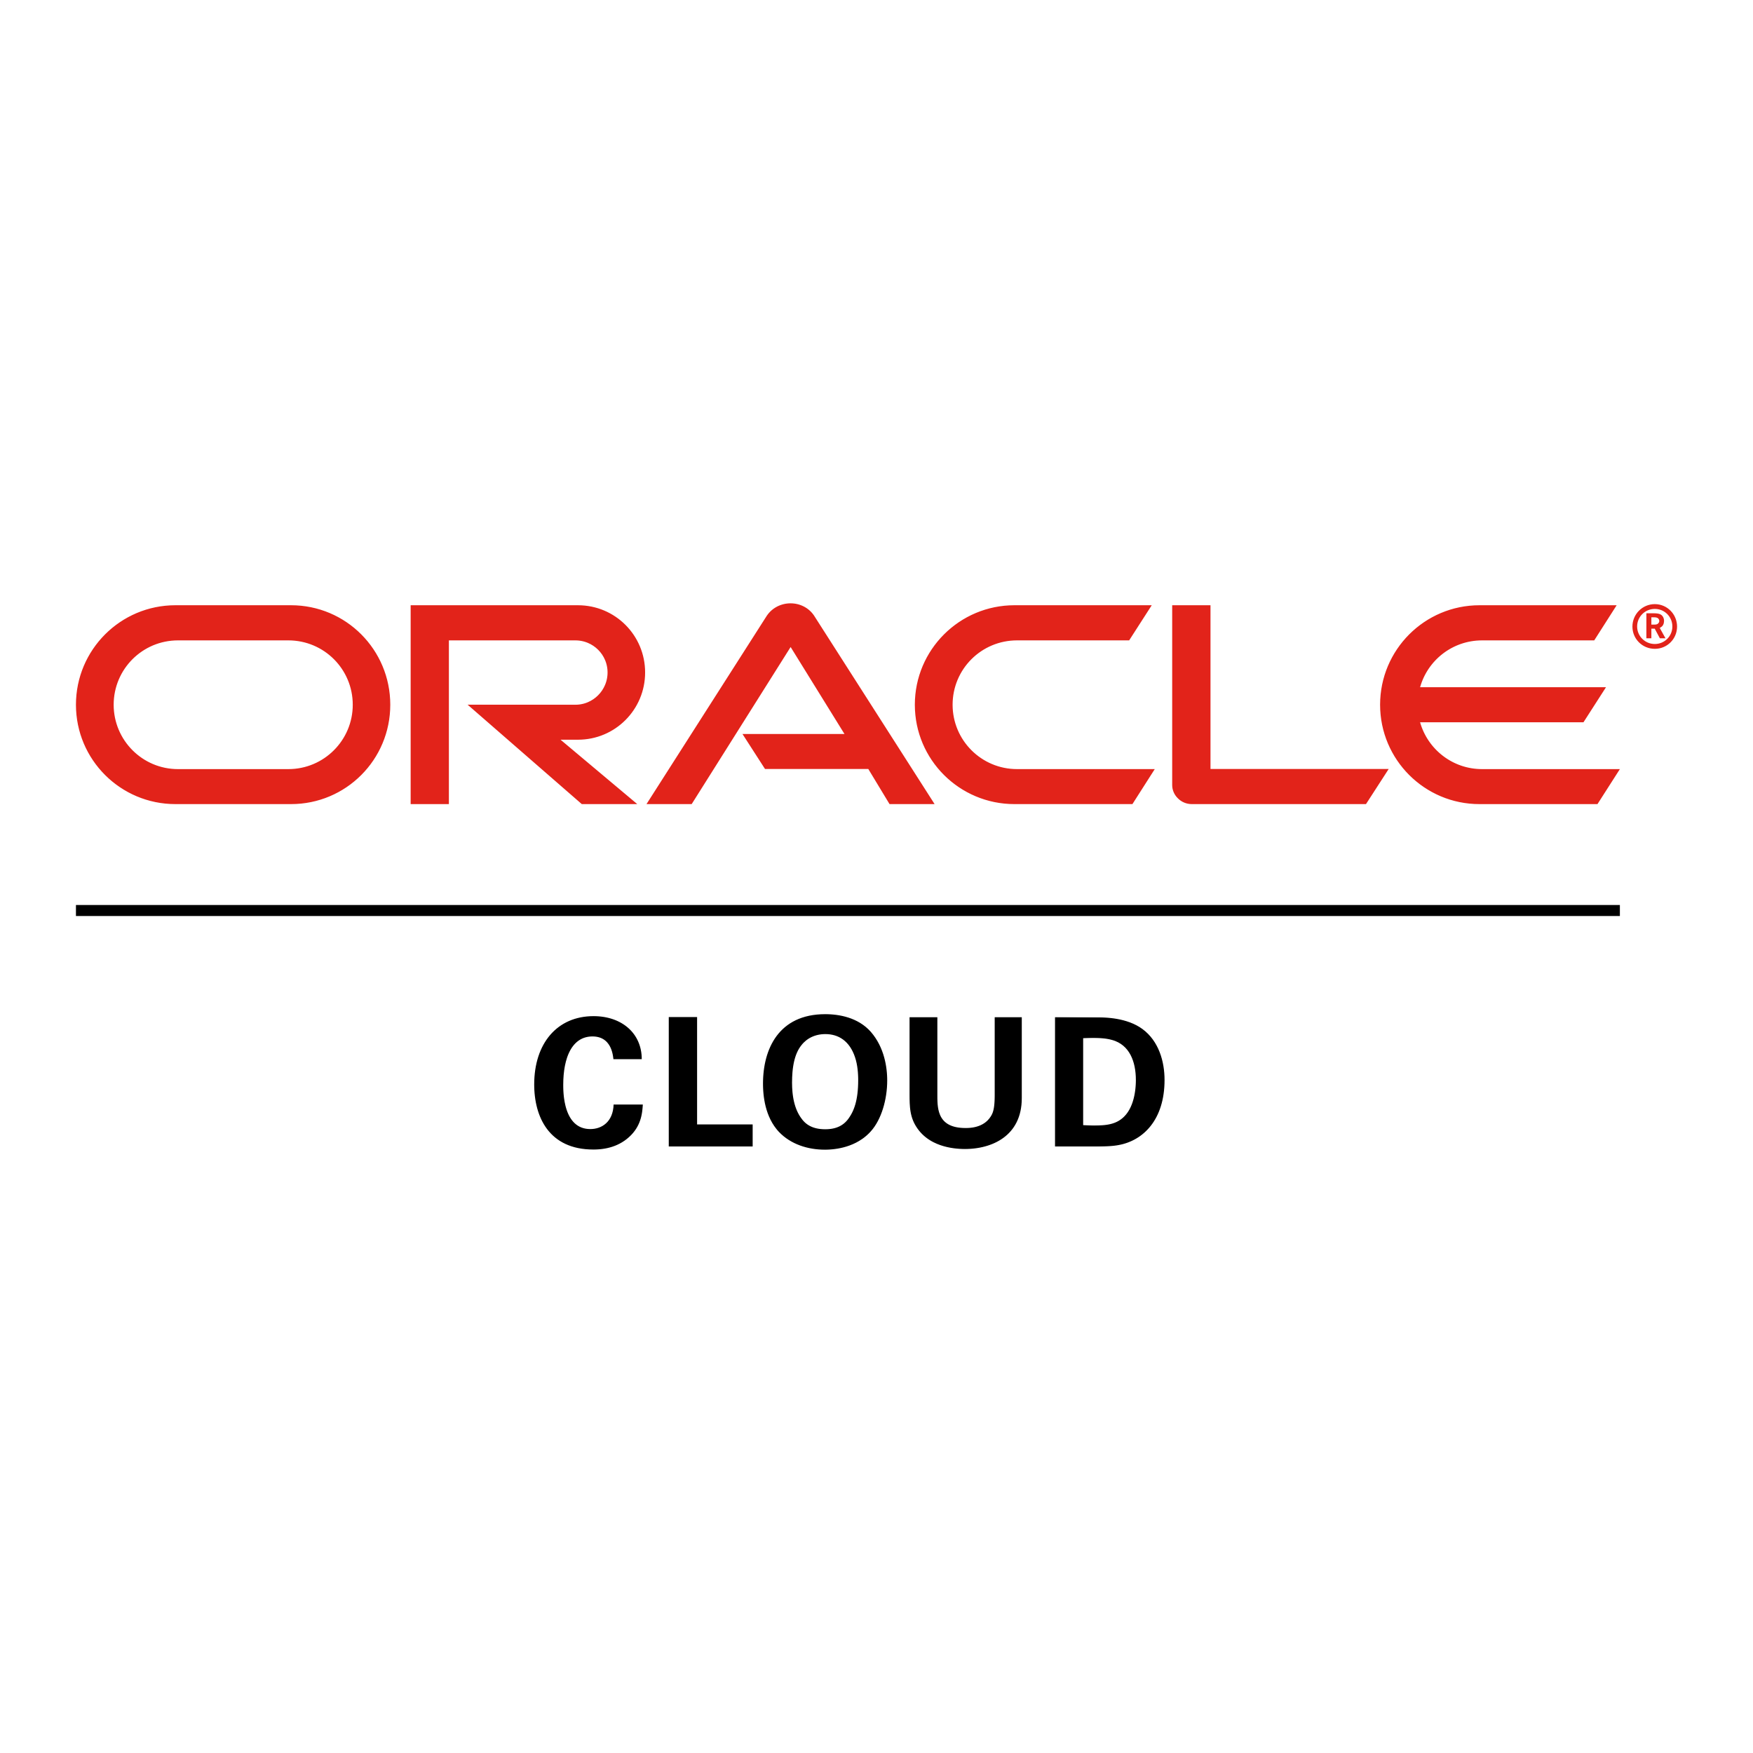
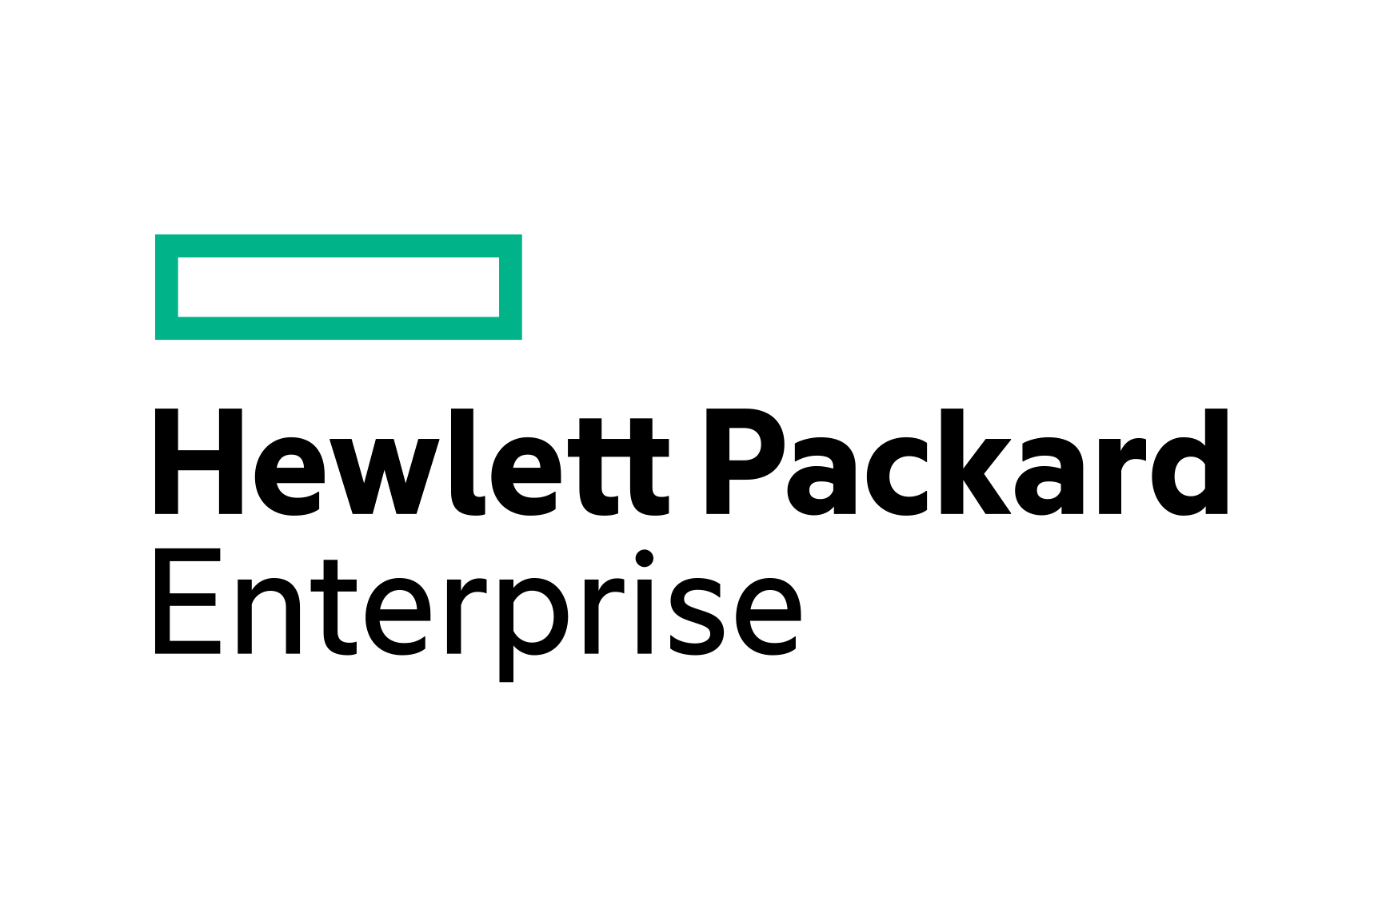


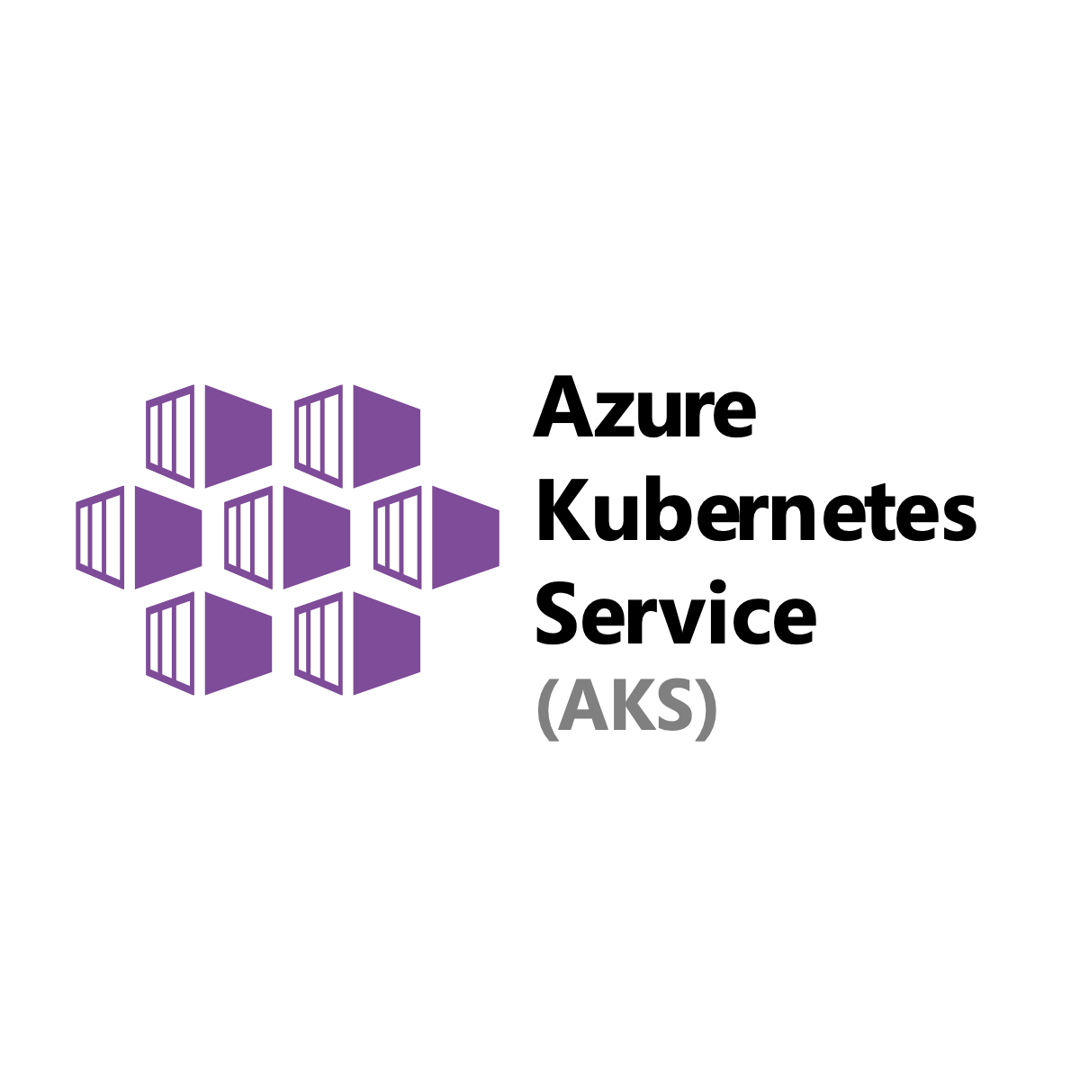

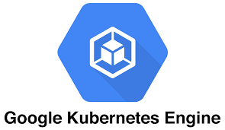

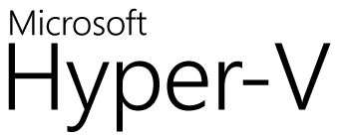
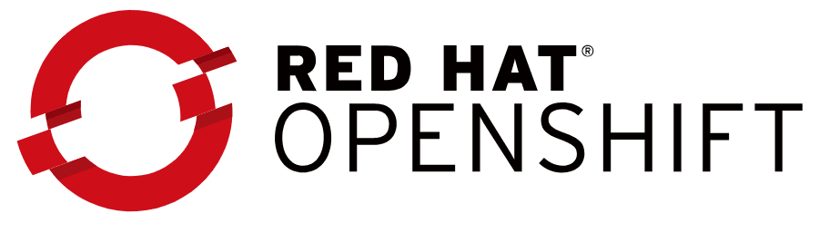
The Zerto Platform
Cloud Data Management and Protection
Orchestration | Automation | Analytics
Disaster Recovery
Continuous Backup
Long-term Retention
Data Mobility
& Migrations
Test & Development
Security & Compliance
Continuous Data Protection
Notes:
Emphasis on CDP and We have also added not only the cloud vendors but now the Kubernetes logos from vendors to show the breadth of what we do

Slide 5




Zerto Capabilities
Repeatability
Reduced Downtime
Visibility
Consistency
Built-in orchestration and automation, the migration workflow is the same from one application to the next
Provides full confidence that the migration will go as planned—with zero data loss and minimal downtime
Nondisruptive testing capabilities allows to migrate the applications without impacting production applications
Built-in disk consistency and write-order fidelity keep the applications consistent between current and target sites

Slide 6
Rehosting Migration Process
Assessment
Define the Migration strategy
Prepare & Replicate the VMs
Test Failover
Migrate the VMs to Cloud
App Validation

Slide 7
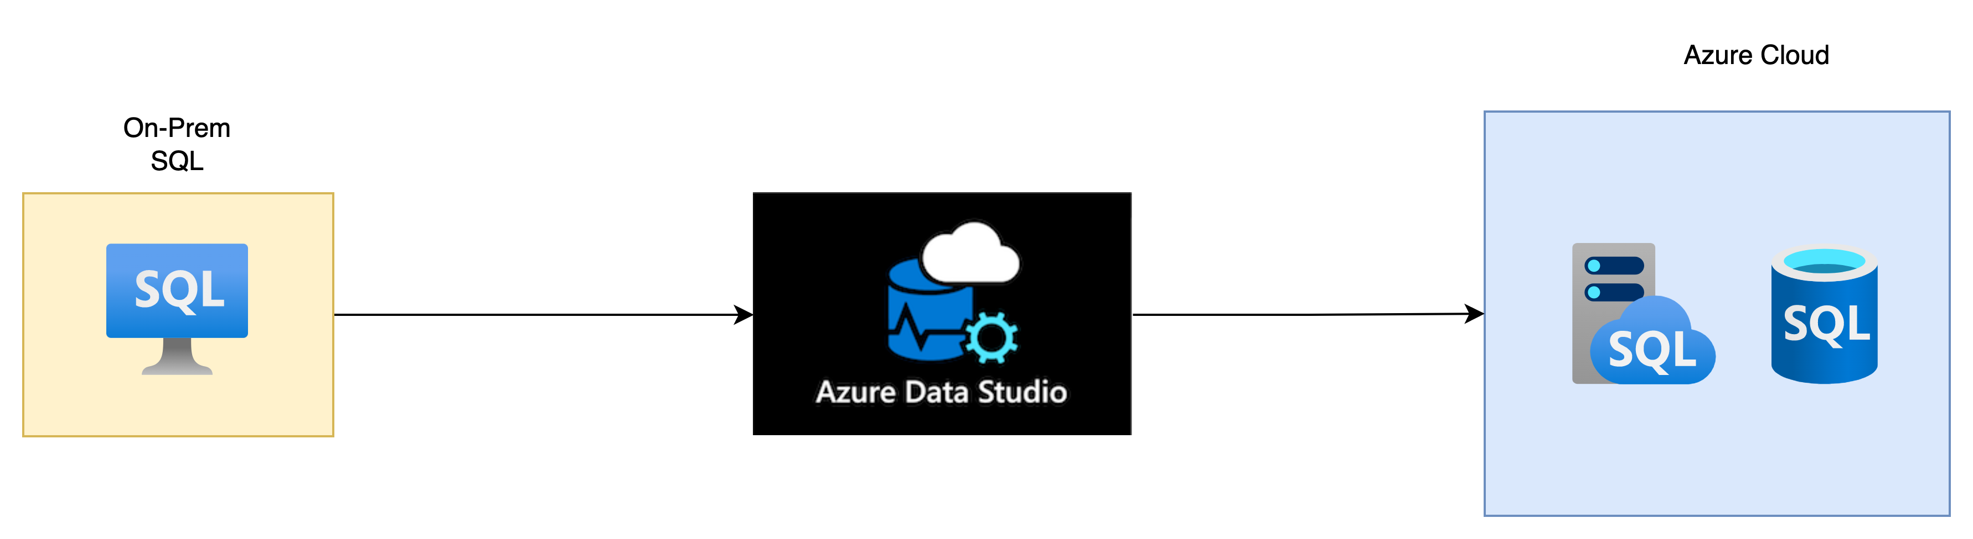
Refactoring – SQL Server Migration
Assessment
Collect Performance Data
Backup the DB
Migrate using Azure DMS
Perform the DB Cutover
DB Validation

Slide 8
Refactoring – App Service Migration
Assess and migrate Apps using Microsoft Native App service Migration assistant
Performs readiness checks and general assessment of App Configurations
Supported workloads - .Net, Java and PHP apps
Assessment
Download App svc Assistant
Migrate
Perform the Cutover

Slide 9
POC Scope
OS | Source | Tech Stack/Application | Migration Strategy | Destination | POC Status
Windows 2022 | VMware VM | IIS, ASP.Net DB – MS SQL Web Application | Lift & Shift | Azure VM | SUCCESS
Ubuntu 22.04 LTS | VMware VM | Apache, PHP,MySQL Wordpress | Lift & Shift | Azure VM | SUCCESS
RHEL 8 | VMware VM | NGINX | Lift & Shift | Azure VM | SUCCESS
SQL Server 2019 | VMware VM | SQL | Refactor | Azure SQL DB | SUCCESS
SQL Server 2019 | VMware VM | SQL | Refactor | Azure SQL MI | SUCCESS
Web Server | VMware VM | ASP.NET | Refactor | Azure Web App | SUCCESS

Slide 10
Demo - Refactor App, SQL

Slide 11

Continuous Data Replication
DATACENTER
BC/DR Site
vCenter/ SCVMM
ZVM
vCenter/ SCVMM
ZVM
VRA
VRA
VRA
VRA
>5 Mbps
VM
VM
VM
VM
VM
VM
VM
VM
One-To-Many Replication
VM
VM
VM
VM
vDisk
vDisk
Notes:
[ZVM]
Easy to deploy; 1:1 relationship with the hypervisor management component
Windows Application
[VRA]
Scale-out architecture ; small footprint
Has built-in compression, bandwidth throttling
Also contains the components for backup and restore (so also scale-out backup architecture)
Continuous Block Level replication (NO performance impact, no snapshots, no agents) = RPO of seconds
All blocks replicated to journal in target site
[Journal]
Simply put; a log that contains all changes that occurred on a VM
Journal Per VM
Offers seconds of granularity
Scales up and down dynamically
Configured through SLA settings (history and size can bet set)

Slide 12
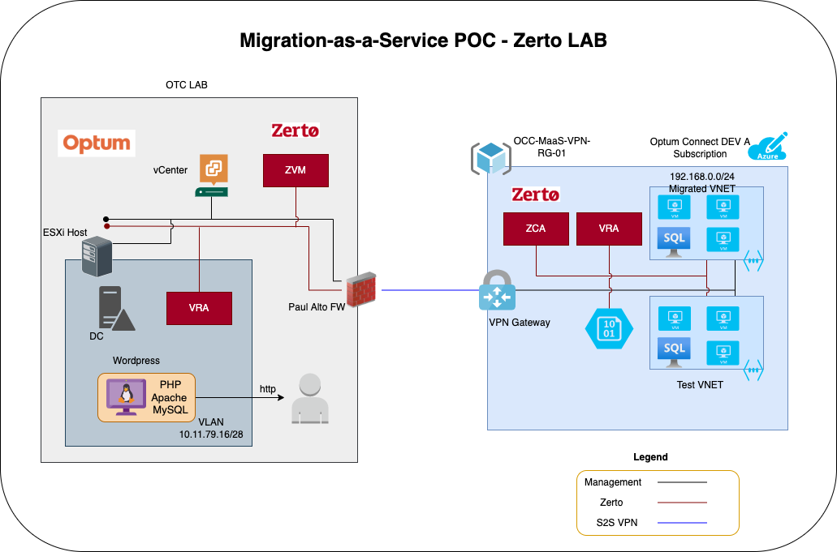
Zerto LAB Architecture

Slide 13
DEMO VIDEO

